Slide 1
Stock Market Analysis with Twitter Sentiment Analysis
- Hardeep Singh
- Vignesh Sriram
- Sarita Shinde

Slide 2
Table Of Content
Introduction
Data Cleaning & EDA
Model Selection
Model Comparison
Sentiment Analysis
Conclusion

Slide 3
Introduction
Sentiment analysis is the use of:
natural language processing (NLP)
computational techniques to automate the extraction or classification of sentiment from typically unstructured text
It is the process of determining whether a piece of writing is positive, negative or neutral

Slide 4
Why Twitter?
Popular microblogging site
240+ million active users ranging from the common man to celebrities
Famous platform to share and discuss personal views of variety of subjects
Message limit of 280 characters, so easier to handle for analysis

Slide 5
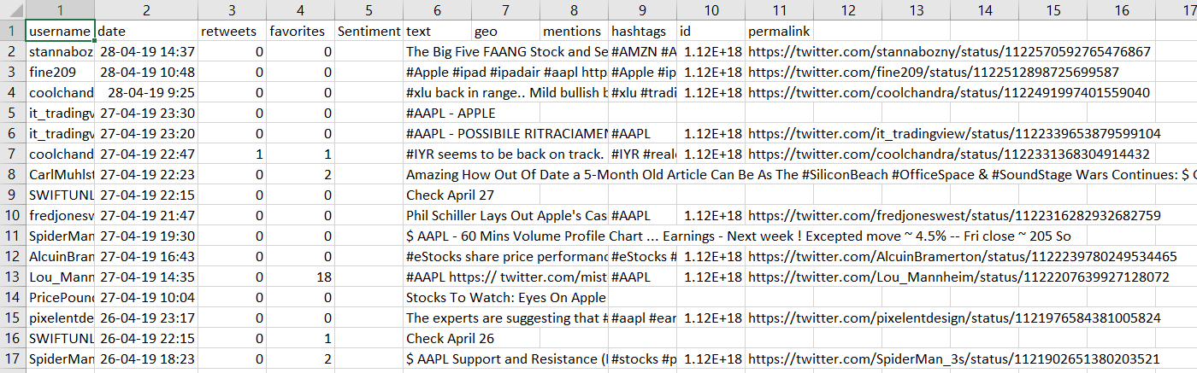
Data Cleaning & EDA
We used Web Scraping tools to fetch data from Twitter

Slide 6
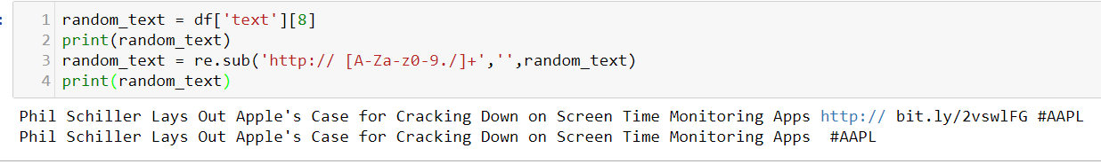
Data Preparation
Step 1: Removing @ mentions: Although this is very important when we tweet but this does not add any value when we are performing Sentiment analysis
Step 2: Removing URL links: Again this adds no importance while calculating the Sentiment Analysis

Slide 7
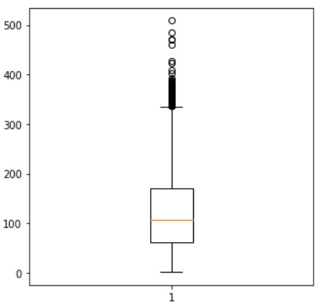
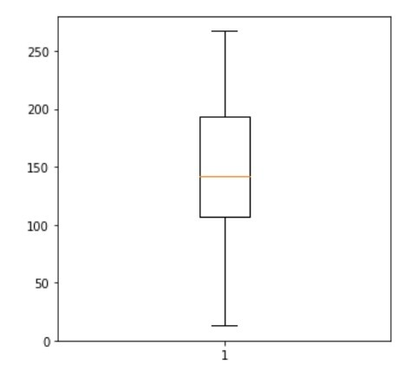
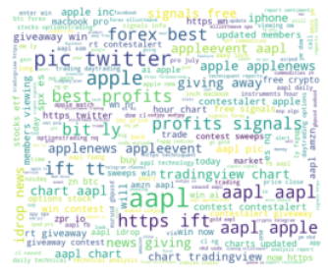
Data Cleaning & EDA
Before Cleaning
After Cleaning
Word Cloud

Slide 8
Text Vectorization
Count Vectorizer
Uses the bag of words approach to tokenize a document and build a vocabulary of known words
Splits each message into a token to count the number of times a word occurs in it
Creates a matrix populated with token counts called the Document Term Matrix(DTM)

Slide 9
TFIDF Vectorizer - (Term frequency–inverse document frequency)
Numerical statistic to reflect the importance of a word in a document collection
Term frequency summarizes how often a given word appears within a document
Inverse document frequency downscales words that appear a lot across documents

Slide 10
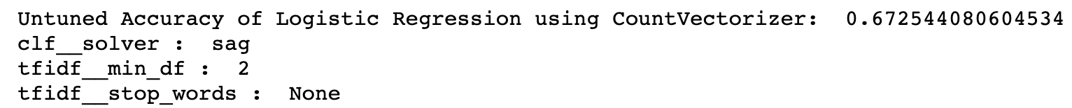
Logistic Regression
Statistical model that uses a logistic function
Often used when the dependent variable is categorical or binary
Using Countvectorizer:

Slide 11
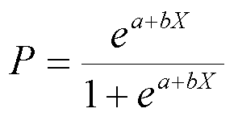
Logistic Regression
Using TfidfVectorizer:

Slide 12
Decision Tree
Supervised learning method for classification
Creates a model that predicts the value of a target variable by learning simple decision rules inferred from the data features
Using Countvectorizer:

Slide 13
Decision Tree
Using TfidfVectorizer:

Slide 14
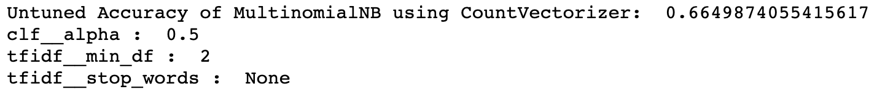
Naive Bayes
Probabilistic classifier that incorporates strong independence assumptions
Assumptions have no impact on reality, hence called “naive”
Using Countvectorizer:

Slide 15
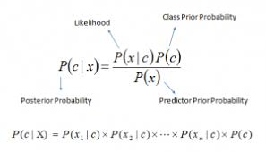
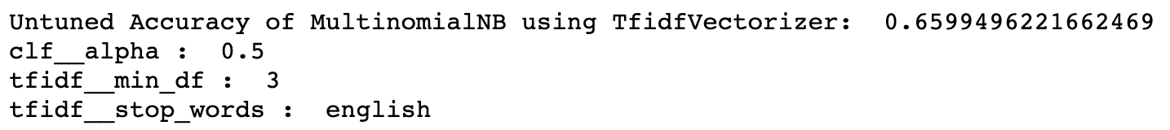
Naive Bayes
Using TfidfVectorizer:

Slide 16
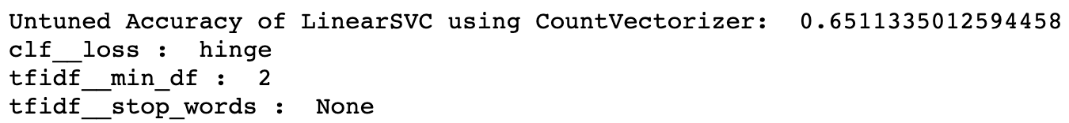
Linear SVC
It is a separating plane
Most “important” training points are support vectors;they define the hyperplane
Using Countvectorizer:

Slide 17
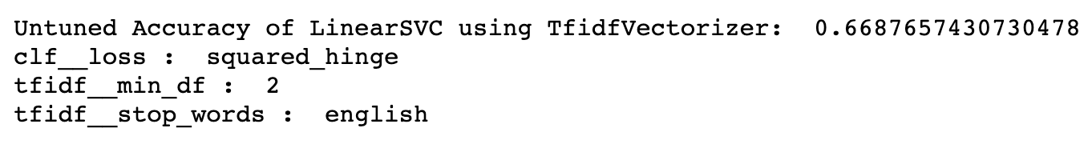
Linear SVC
Using TfidfVectorizer:

Slide 18
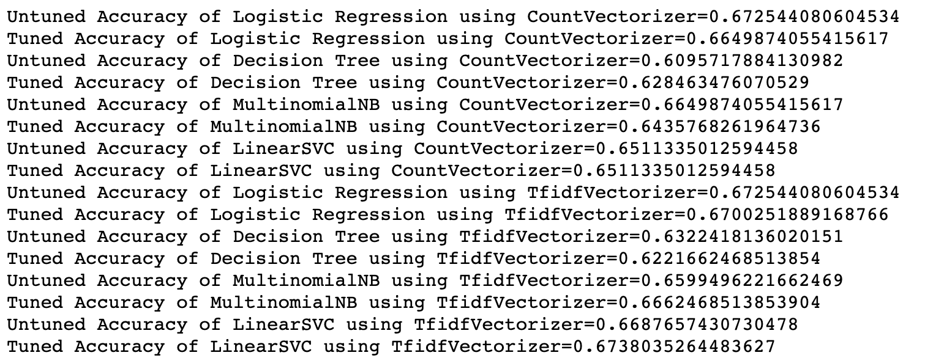
Model Comparison

Slide 19
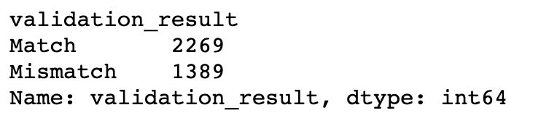
Checking result

Slide 20
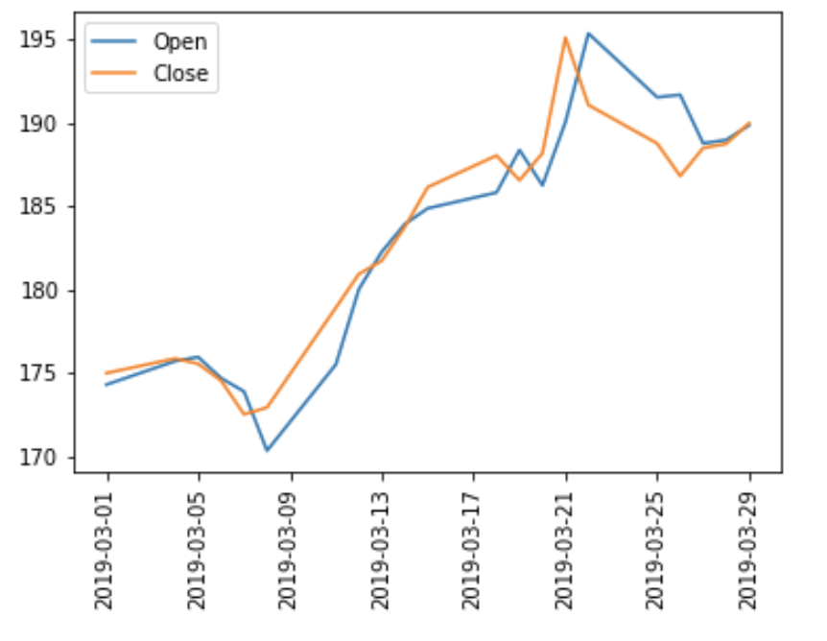
Stock Performance

Slide 21
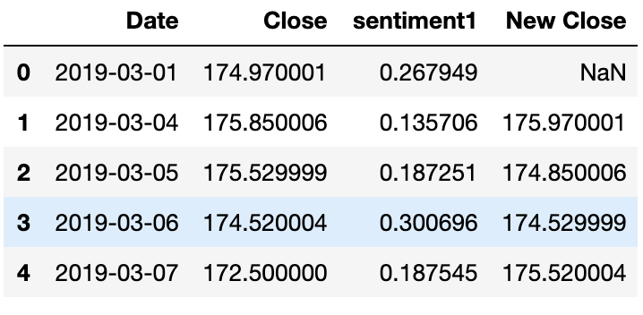

Actual Close vs Predicted Close

Slide 22
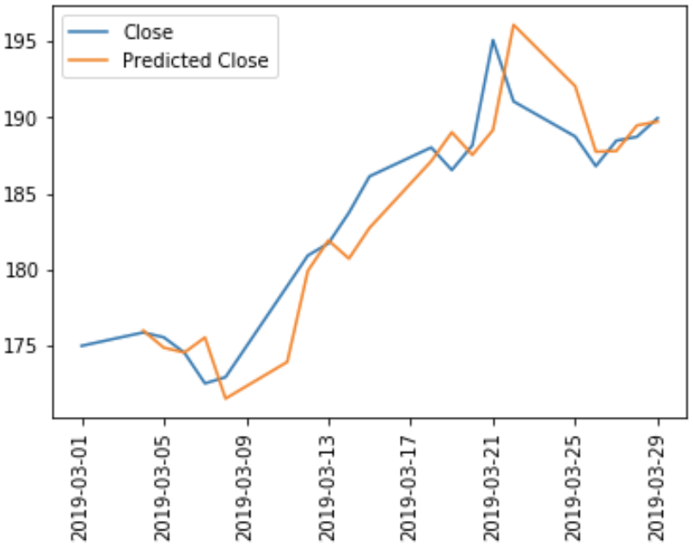
Actual Close vs Predicted Close

Slide 23
Conclusion & Future Scope
Achieved 67% accuracy for the models
Achieved 85% accuracy in predicting the next day closing based on previous day’s sentiment
Useful tool to not only make investment decisions, but also to pacify investors from falling prey to volatility due to social media
In future, we would work on getting better accuracy

Slide 24
References
https://github.com/tthustla/twitter_sentiment_analysis_part1/blob/master/Capstone_part2.ipynb
https://journals.plos.org/plosone/article?id=10.1371/journal.pone.0144296
https://towardsdatascience.com/the-real-world-as-seen-on-twitter-sentiment-analysis-part-one-5ac2d06b63fb

